Slide 1
~Choonz~
Group P ITECH 2020
- Duncan Wright 1002243w
- Mark Darroch 2146229d
- Caine Simpson 2138307s
- Stuart Armit 2495357a
Notes:
Caine’s Notes: On creation of playlist user could be presented with text fields to fill in to describe the playlist such as era, genre, etc. Could also give the option to add custom tags such as location? Also could have drop down for genre, larger text box for general description, and smaller textbox for tagging (See soundcloud tagging system)

Slide 2


User Requirements and Design
Rio - 19 year old, music lover, likes to create playlists to share with her friends. Proud of eclectic music taste, wants a way to share with a wider audience. Competitive, wants to prove to herself and her friends that her playlists can rank among the best in the world.
Joe - 40 year old, priest, loved Norwegian Black Metal scene in his youth, always searching for 90s Black Metal playlist, needs a way to rate and review playlists/guide lost souls with constructive criticism.
Valerie - 22 year old, Scottish Literature student, can only study to 1980s Japanese Ambient House music, needs to find playlists of this description, needs to search playlists with specific tags (such as genre, tempo or era).
Key Requirements
Users can create a playlist and add their favourite songs to it.
Playlists can be tagged with keywords, allowing for greater visibility and specificity when searching.
All users can rate/review playlists on the site, developing a ranking of the best/most highly rated Playlists.
Users can filter/search Playlists based on tags, creators or creation date so that they can stay up to date with the type of music they love.
If a particular genre is niche and under-represented, a user can create a new tag to advertise their eclectic tastes.

Slide 3
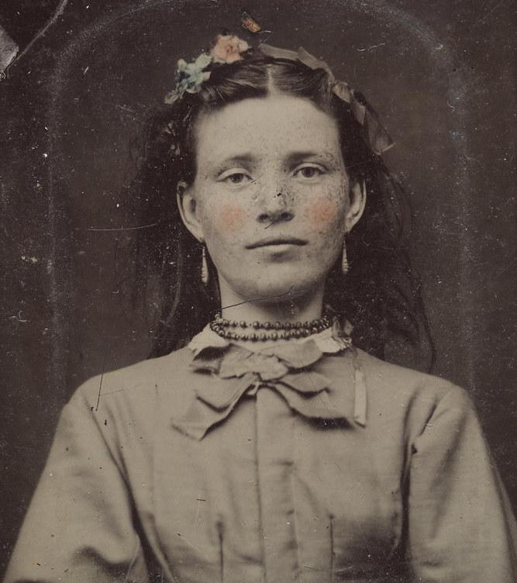
Her Name Is Rio...
… and she is a 19 year old music lover from Chihuahua City, Mexico. In her spare time Rio likes to create playlists to share with her friends. She is very proud of her excellent and eclectic music taste, and so she feels that she needs a way to share her playlists with a wider audience.
Rio is also somewhat competitive, and would love a way to prove to herself and her friends that her playlists can rank among the best in the world.
User Persona #1
Vestland. (2010). Flickr.com

Slide 4
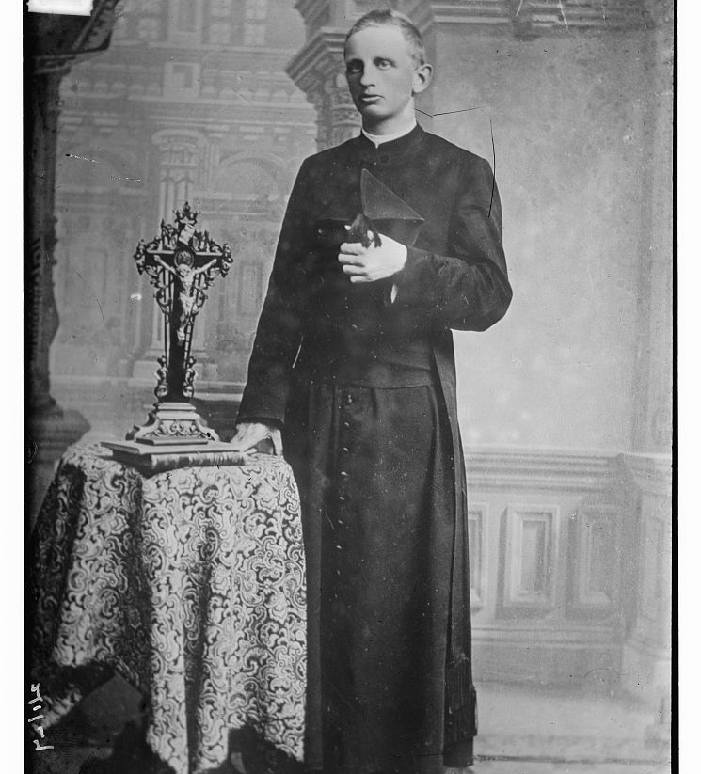
Hey Joe...
A 40 year old priest from Oslo, Joe fell deep into the Norwegian Black Metal scene as a youth and, despite his new life as a man of the cloth, still harbours a forbidden love for those rage-filled guitar riffs and shrieking vocals .
Joe is always searching for the perfect 90s Black Metal playlist, but finds that no one ever seems to capture that perfect blend of nihilism and dread. What Joe needs is a way to rate and review playlists, and guide these lost souls with constructive criticism.
User Persona #2
Brain News Service. (ca. 1910-1915). LoC.gov

Slide 5
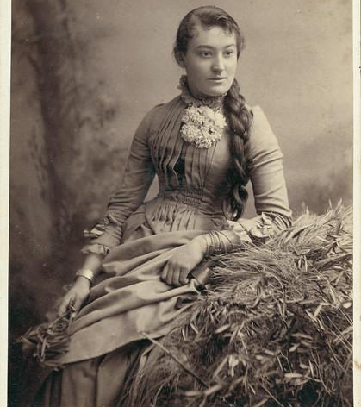
Come On Over Valerie...
Valerie is a 22 year old Scottish Literature student from Glasgow. Valerie finds that she can only study while listening to 1980s Japanese Ambient House music.
She needs to find the highest ranking playlists of this description to get some work done, but realises that this is a somewhat niche request.
So for this reason she needs a way to search for playlists that have specific tags (such as genre, tempo or era).
User Persona #3
Duryea, T. (ca.1850-1900).maas.museum

Slide 6

Design Specifications - Status
Must
Allow users to create an account
Must
Allow account holders to create playlists
Must Allow users to rate/review others’ playlists
Must
Show users the top rated playlists within a certain time period
Should
Allow users to link to playlists/songs from streaming sources
Should
Allow account holders to apply tags to their playlists
Should
Allow users to filter playlists by tags
Should
Give account holders playlist recommendations based on playlists they have rated
Could
Allow users to login via Spotify¹/Twitter²
(also added GitHub³ login)
Could
Allow users to follow other users
Could
Introduce a multi-attribute rating system, so users can rate playlists on separate, distinct criteria, e.g. ‘replayability’
*Deemed unnecessary as rating system is sufficient to allow user visibility already.
¹ Spotify. (2020). https://www.spotify.com/
² Twitter. (2020). https://about.twitter.com/
³Github. (2020). https://github.com/

Slide 7
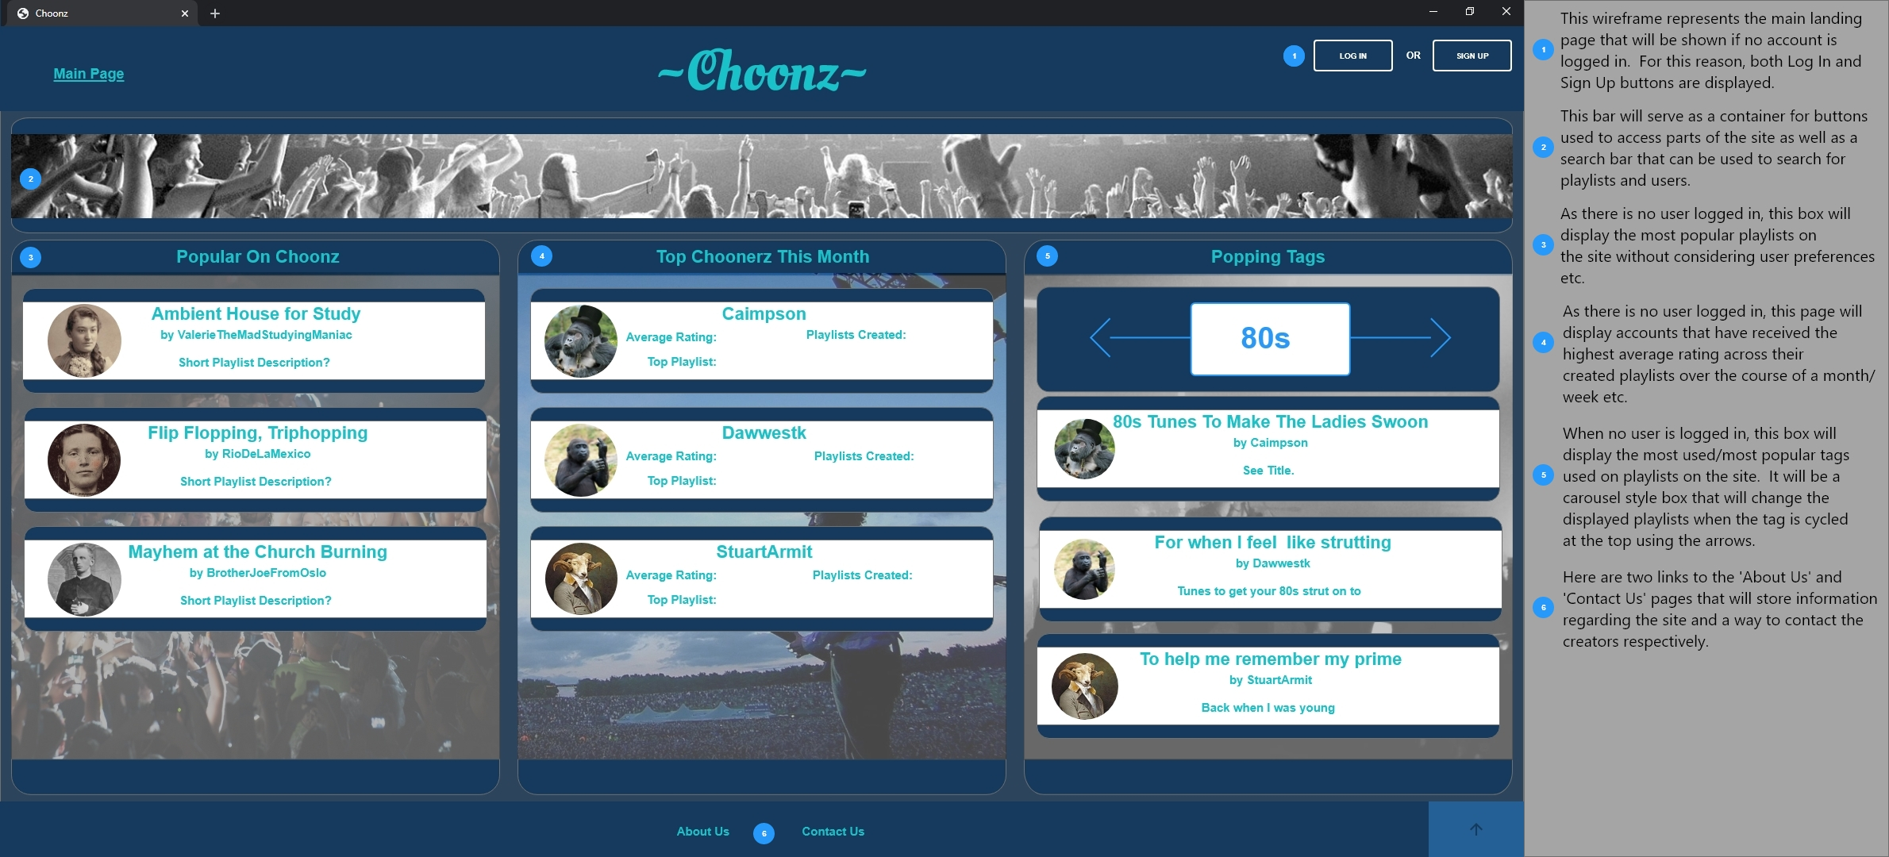
Wireframe - Homepage
With this app, I’m confident to plan a trip to rural Vietnam
Wendy Writer, CA
Visual translation feels like magic
Ronny Reader, NYC
Translate has officially inspired me to learn French
Abby Author, NYC
Quotes for illustration purposes only

Slide 8
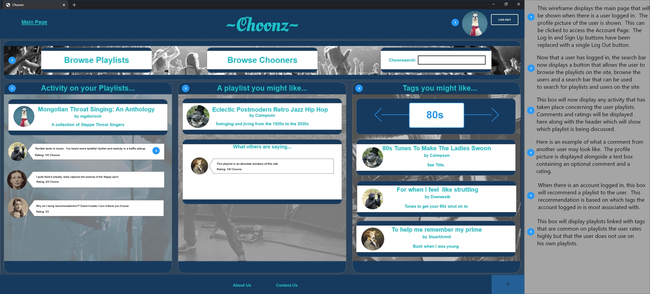
Wireframe - Login/Signup
With this app, I’m confident to plan a trip to rural Vietnam
Wendy Writer, CA
Visual translation feels like magic
Ronny Reader, NYC
Translate has officially inspired me to learn French
Abby Author, NYC
Quotes for illustration purposes only

Slide 9
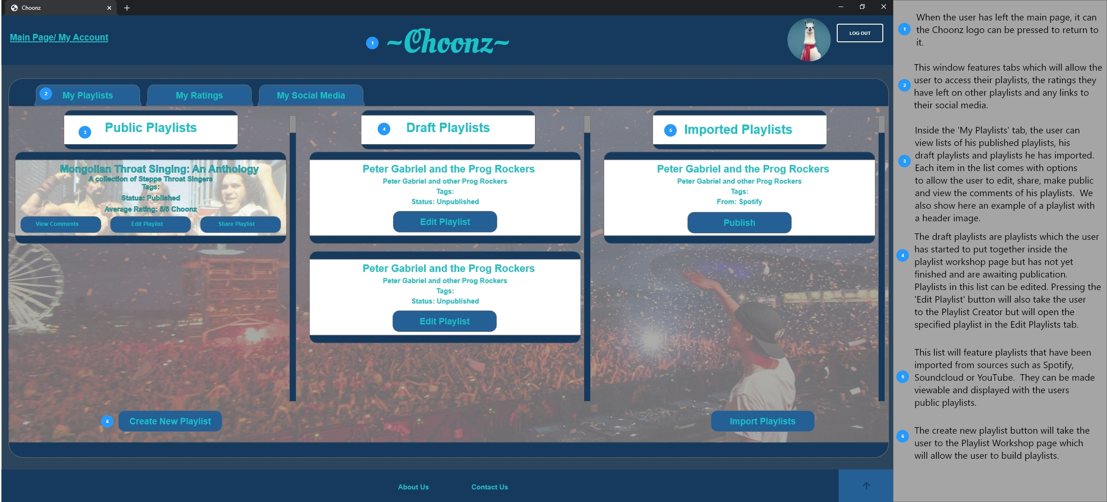
Wireframe - My Playlists
With this app, I’m confident to plan a trip to rural Vietnam
Wendy Writer, CA
Visual translation feels like magic
Ronny Reader, NYC
Translate has officially inspired me to learn French
Abby Author, NYC
Quotes for illustration purposes only

Slide 10
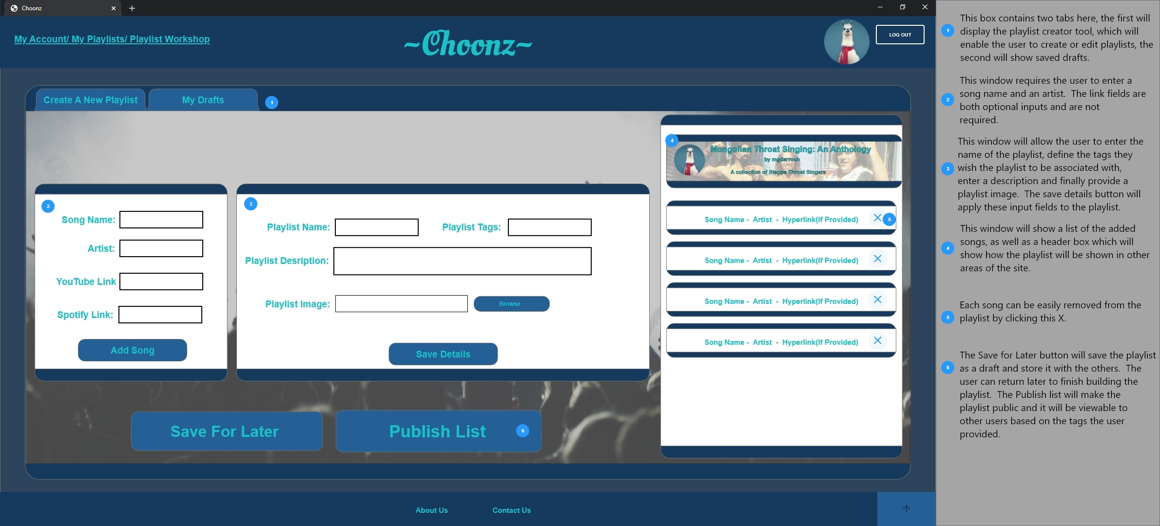
Wireframe - Playlist
With this app, I’m confident to plan a trip to rural Vietnam
Wendy Writer, CA
Visual translation feels like magic
Ronny Reader, NYC
Translate has officially inspired me to learn French
Abby Author, NYC
Quotes for illustration purposes only

Slide 11
Future Expansion
Request: “These playlists are great, but I love live music! When are these bands playing?
Solution:
Part 1) Expand the role of Artists in the application, create Artist pages.
Part 2) Incorporate link to TicketMaster (or similar) API showing touring schedule of a user’s favourite artists.
Request: “Can I export this playlist to listen to while out and about?”
Solution:
Current functionality leans heavily on Spotify, so exporting a playlist there would be a manageable task, given development time. If export to another media streaming service was required, it would require a new connection to the service’s API (NOTE: export to mp3 or similar is not possible as we do not own media)
Request: “Comments in reviews are helpful but I’d love a longer discussion with fellow fans”
Solution:
Implementation of a forum has been discussed for future iterations of the application. This would allow users to open up a wider discussion on the finer details of their playlist choices.

Slide 12
Application Development
Specification:
The final application varied both in scope and design from the original Design Specification document. For example, it was originally thought that Artists would play a larger role in the site, but in the building of the application it was found that they were not nearly as significant as expected.
Development Challenges:
As a group, our collective prior experience with JavaScript, jQuery, AJAX and CSS was close to nil. Thus, all aspects of the design and implementation of the application were learned in development. Libraries such as Bootstrap were used for some functionality, as spending time to create a unique design for basic components and interactions seemed like re-inventing the wheel.
Database and Model changes:
While the model was updated a couple of times, the edits were mainly superficial as the original design spec had been reasoned through fairly well. For example, nearly all objects in the model now have a slug for easier identification – something that was overlooked in the original spec. As mentioned above, the Artist object had a number of attributes removed, however, the main object relationships remained unchanged (see Model Updates).

Slide 13
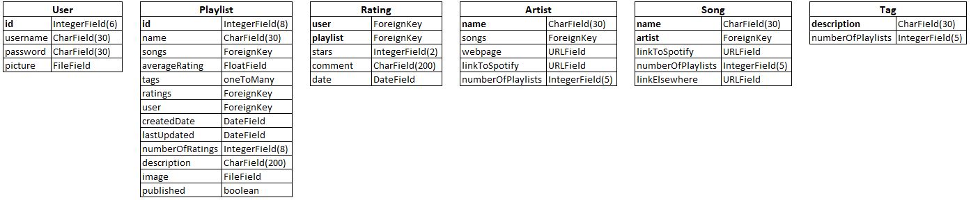
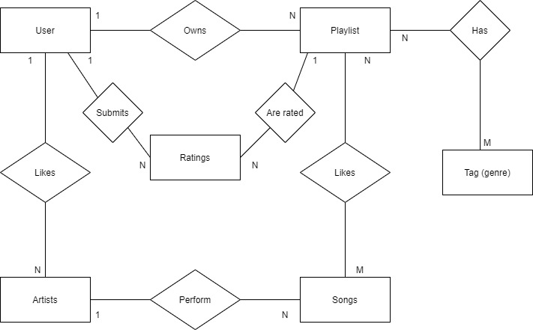
Model Updates: Before
From Design Specification:

Slide 14
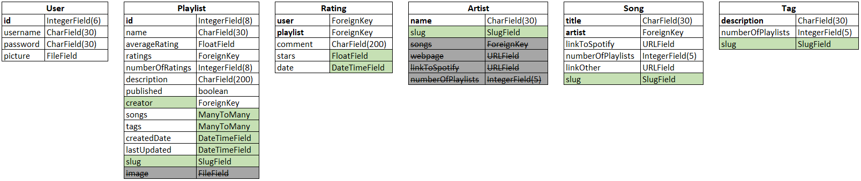
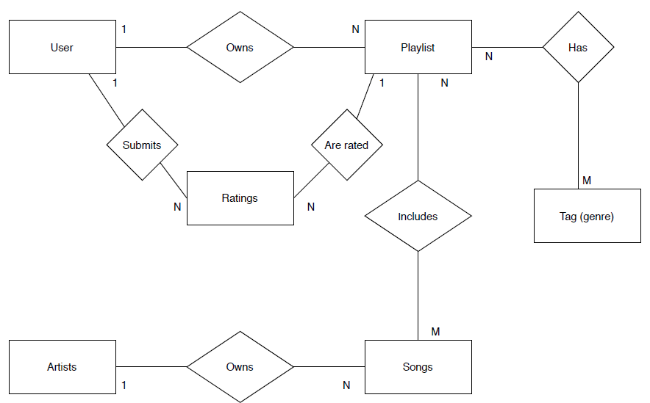
Model Updates: After
Current Model Design:

Slide 15
URL Listing
General URLs available from all pages
about/
contact/
add_playlist/
list_playlists/
Playlist URLs
playlist/< name >/playlist/< name >/rate_playlist/
playlist/< name >/edit_playlist/
playlist/< name >/edit_playlist/add_song/
playlist/< name >/edit_playlist/remove_song/
playlist/< name >/edit_playlist/delete_playlist/
playlist/< name >/import/
Profile URLs
profile/< username >/
profile/< username >/my_stats
Helper URLs for request handling
search_spotify/
register_profile/
publish_playlist/
add_new_song_details/
Suggestion URLs (AJAX)
suggest_tag/
suggest_playlist/
filter_playlists/

Slide 16
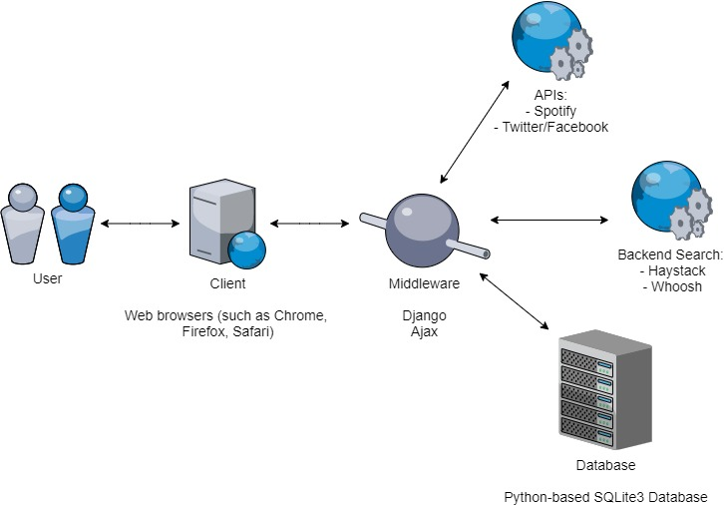
System Architecture
The System Architecture has been edited to replace the Backend Search APIs with a simple python SQL search system (implemented by the group).
Facebook was removed from the APIs and replace with Github
+ Github
+ Python/SQL search of database

Slide 17
System Architecture Diagram

Slide 18
Site Map
Home
About Us
Contact Us
Playlists
Playlist
Register
Login
My Account
Review
My Account
Creator Page
My Playlists
Playlists
Create a Playlist

Slide 19
URLs
/home - Stuart
/about
/contact
/register - Duncan
/login - Duncan
/myaccount - Caine (same as user profile)
/myaccount/myplaylists
/myaccount/myplaylists/create - Mark
/playlists/
/playlists/<playlist-name>
/playlists/<playlist-name>/review
/users/
/users/<username> (Note: for particular user’s page) - Caine

Slide 20
Entity-Relationship Diagram

